Slide 1
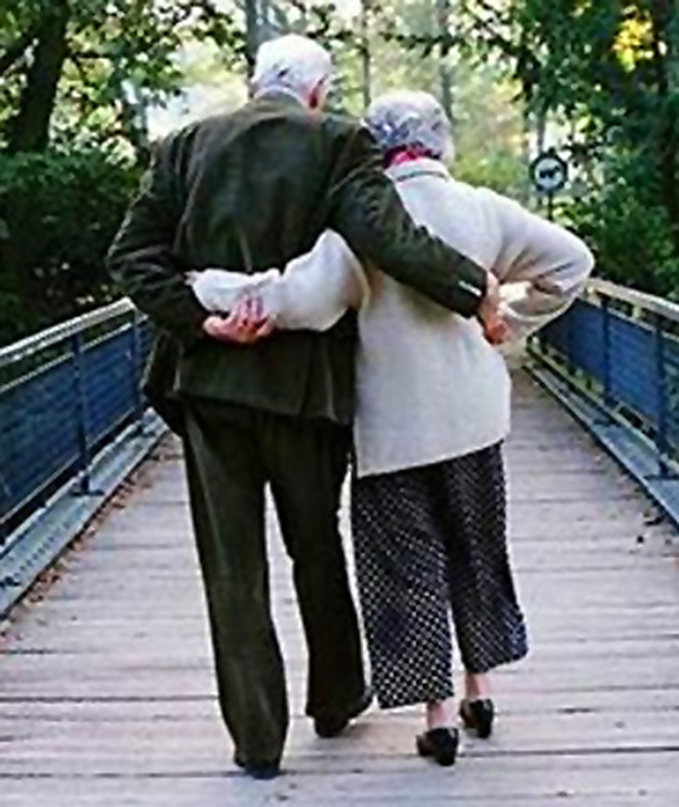
Married: Growing & Serving Together
A Study of Marriage, Spring 2023

Slide 2
Singleness in God’s Family
Singleness in God's Family
Singleness in God's Family
Singleness in God's Family
The right way to view singleness & how to serve if single
The Right Way To View Singleness and How We Might Serve

Slide 3
God’s Valuation of Marriage and Singleness
Is one state necessarily better than the other?
“To the present hour we hunger and thirst, we are poorly dressed and buffeted and homeless, and we labor, working with our own hands. When reviled, we bless; when persecuted, we endure; when slandered, we entreat. We have become, and are still, like the scum of the world, the refuse of all things.” I Cor 4:11-13

Slide 4
Singleness In This Present Distress
“I think that in view of the present distress it is good for a person to remain as he is.” I Cor 7:26
The Apostle does not command that marriages be broken or abandon

Slide 5
Singleness – Avoiding Worldly Trouble
“But if you do marry, you have not sinned, and if a betrothed woman marries, she has not sinned. Yet those who marry will have worldly troubles, and I would spare you that.” I Cor 7:28
This can force the terrible choice between Christ and family
Family life takes time and attention

Slide 6
The Value/Benefit of Singleness
Single life can free you to be more involved in the Lord’s work
It gives you a greater opportunity to focus on God and deepen your own faith

Slide 7
The Value/Benefit of Singleness
A single life can be used to develop other relationships in your life
A single life can teach you how to be content in Christ even when life is not how you want it to be

Slide 8
The Value/Benefit of Singleness
“I want you to be free from anxieties. The unmarried man is anxious about the things of the Lord, how to please the Lord. But the married man is anxious about worldly things, how to please his wife, and his interests are divided. And the unmarried or betrothed woman is anxious about the things of the Lord, how to be holy in body and spirit. But the married woman is anxious about worldly things, how to please her husband. I say this for your own benefit, not to lay any restraint upon you, but to promote good order and to secure your undivided devotion to the Lord.” I Cor 7:32-35

Slide 9
Growing and Serving as a Single Person
Marriage is good and right in God’s sight
So is being single
Christianity holds up both states as honorable.
You are not in terrible marriage

